Slide 1


Making the world more active
Helping every young person live a life that moves them

Slide 2

What is miMove?
miMove is designed for schools who are concerned about their students’ mental and physical wellbeing …
who want to measurably improve engagement with both physical and enrichment activities…
as a significant contributor for health and happiness and building a sense of belonging.

Slide 3

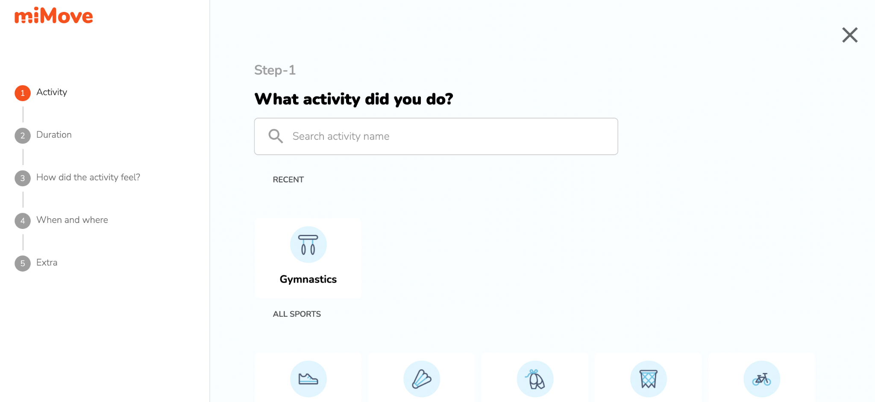
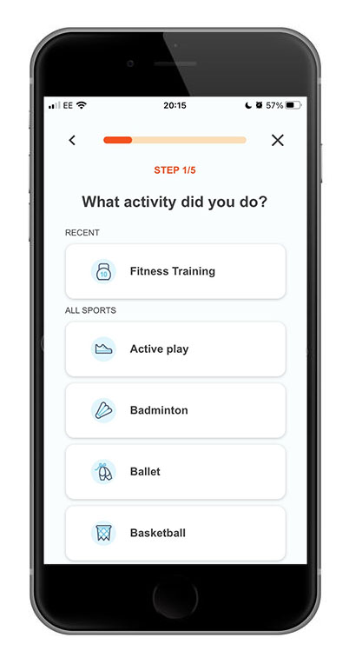
miMove lets every child be seen and heard
Easy to use
Self-reported
Captures all activity in and out of school
No wearable device needed
Accessed via online device and/or mobile app
Students record
  Type of activity
  Duration
  Who they did activity with
  Setting
  Emotional response

Slide 4
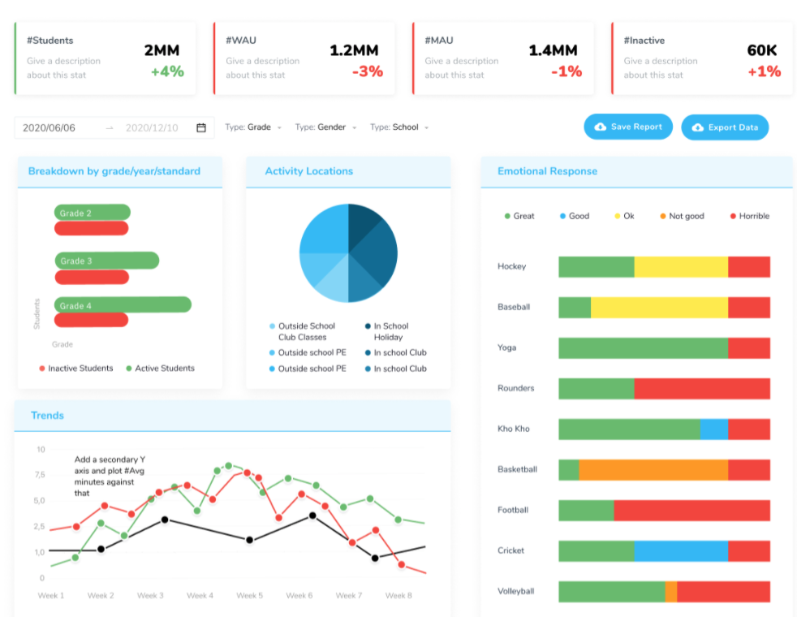
miMove for teachers
Easily captures student voice
At-a-glance activity levels from whole school
to each student
Filter the data to ensure all students are
active & see how they are coping
Data monitors impact & supports decision making
New for 2025 - AI Co-pilot to save time
and analyse the data

Slide 5

Benefits of miMove to your school
Data highlights student wellbeing, allowing for early intervention to help them stay well
Encourages students to be accountable for their
physical and enrichment activity participation
Provides strong evidence of IMPACT for Ofsted
Allows you to evidence and showcase your work
Helps you provide a genuinely inclusive offer
Adds to your current metrics

Slide 6

Why another digital platform?
Bespoke solution for schools & young people
Quick and easy to use
Saves teacher time
Flags wellbeing issues
Every student is seen and heard. Inclusion at the heart of miMove

Slide 7

Evidence of impact
Used across the full range of types of schools
40% increase in student activity and 30% increase in family activity*
Crawshaw Academy won Leeds Sport award for their use of miMove and impact it has had on student activity
Many schools are using miMove as integral tool in their Health and Wellbeing strategies
* Crispin school survey 400 student respondents

Slide 8
GDPR & Digital Safeguarding
Fully GDPR compliant
Click here for privacy policy
Green light from the App Store & Google Play who set high threshold for apps for children
Larger MATs & other groups have carried out digital safeguarding due diligence and are happy to pass miMove e.g.Harris Federation/United Learning
Name, Year, Class, Gender required
SEND, EAL, Ethnicity, Pupil Premium Optional (allow fuller analysis)

Slide 9

Next steps
Contact miMove to come onboard
miMove opens your school account
Access to full support package
Set up accounts (Wonde integration in UK)
Launch
Celebrate, validate and support

